Slide 1

Dental clinic management system
HAZMAN BIN BADRUNSHAM (52213116153)
AMIN SHAMIR BIN AZMAN(52213117477)
NAJIHAH BINTI NASIR(52213117078)
SITI HAJAR BINTI MOHAMAD FAUDZI(5223116128)
SITI NOOR HASIMAH BINTI HAMDAN(5223116107)

Slide 2
INTRODUCTION
Dental Management System is a system used by the Dental Clinic to manage all record such as, patient information, the dentist information, and procedure information. Dental Management System also keep track of the billing information and history of a patient procedures. Online management is more effective to keep track of the patients, dentists, procedure, and billing history. Recognizing the effectiveness of the online management, there is an urge need to reconstruct the old system to be improved and provide a better environment for the staffs.

Slide 3
PROBLEM STATEMENT
There are problems that need to be resolved due to the old dental management system, which was done manually. Other issues occur when using old system comprise of the following:
The staff cannot keep track on the history of a patient and procedure done.
Required a lot of space to store all the files on patient information which may not been used anymore.
It causes a lot of hassle to search for patient information if they ever return for an appointment or a walk in.

Slide 4
AIM AND OBJECTIVES
Aim
To improve the current management system used in a dental management by providing a platform for the staff to use.
Objective
To make retaining the patient information easier by developing the Dental Management System.
To facilitate process of recoding dental examination record.
To make tracking the billing information easier.

Slide 5
PROJECT SCOPE
Staff will be able to manage patient details.
Staff will be able to manage dentist information.
Staff will be able to manage invoice information
Staff will be able to manage insurance details
Dentist will be able to record patient’s dental examination result.
Dentist will be able to provide medical leave to patient
Staff will be able to manage medicine inventory

Slide 6
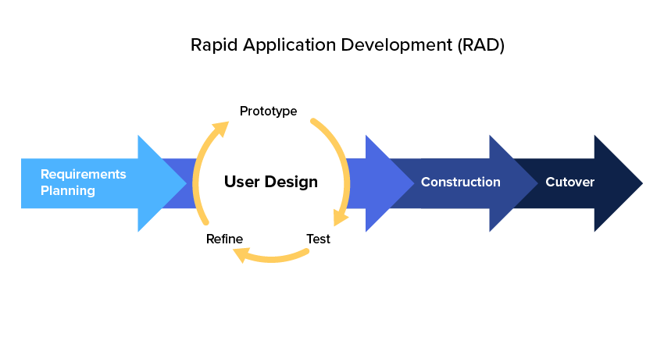
METHODOLOGY

Slide 7
Organizational Chart
Project Manager
Hazman bin Badrunsham
Quality Assurance Manager
Amin Shamir Azman
Implementation Manager
Siti Noor Hasimah binti Hamdan
Configuration Management Manager
Siti Hajar Binti Mohamad Faudzi
Design Manager
Najihah Nasir

Slide 8
CHANGE REQUEST MANAGEMENT

Slide 9
CR ID | Assigned To | Date Completed | Reviewed By | Approved By
CR CCMS - 001 | Hazman | 17/10/2019 | CMM | PM
CR CCMS - 002 | Hazman | 10/11/2019 | CMM | PM
CR CCMS - 003 | Hajar | 17/10/2019 | CMM | PM
CR CCMS - 004 | Hasimah | 12/11/2019 | CMM | PM
CR CCMS - 005 | Najihah | 12/11/2019 | CMM | PM
CR CCMS - 006 | Amin | 12/11/2019 | CMM | PM
CR CCMS - 007 | Hasimah | 5/11/2019 | CMM | PM
CR CCMS - 008 | Amin | 10/11/2019 | CMM | PM
CR CCMS - 009 | Najihah | 10/11/2019 | CMM | PM
CR CCMS - 010 | Hajar | 10/11/2019 | CMM | PM

Slide 10
Change request DETAIL

Slide 11
CR ID | CR Description | Priority | Implemented
CR CCMS - 001 | Add visible password | Medium | Yes
CR CCMS - 002 | Add invoice printing function | Medium | Yes
CR CCMS - 003 | Add application logo | Low | Yes
CR CCMS - 004 | Add new table in database | High | Yes
CR CCMS - 005 | Add medicine inventory function | Medium | Yes
CR CCMS - 006 | Standardized user interface design | Low | Yes
CR CCMS - 007 | Add edit and delete function patient and staff details | High | Yes
CR CCMS - 008 | Add medical leave function | Low | Yes
CR CCMS - 009 | Add medical report function | High | Yes
CR CCMS - 010 | Add visible loading progress | Medium | Yes

Slide 12
Change request implementation result

Slide 13
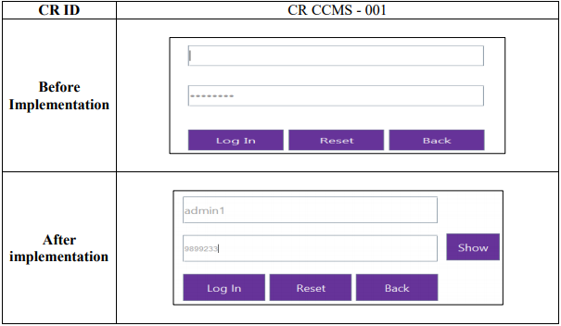

Slide 14
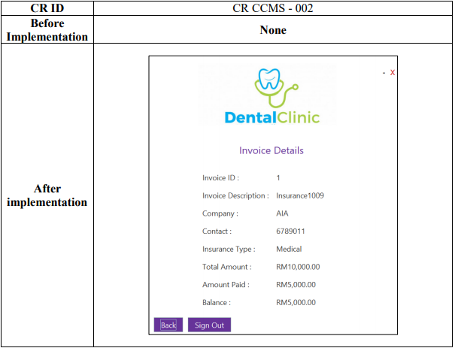

Slide 15
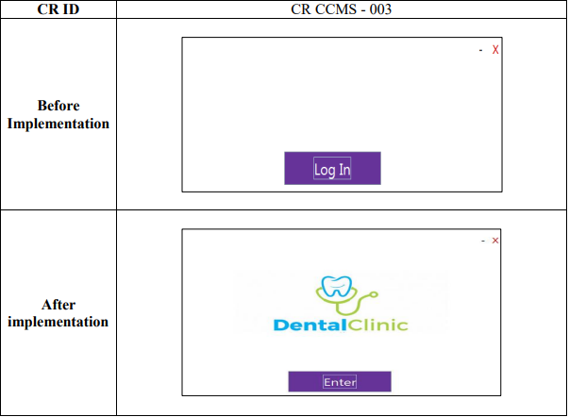

Slide 16
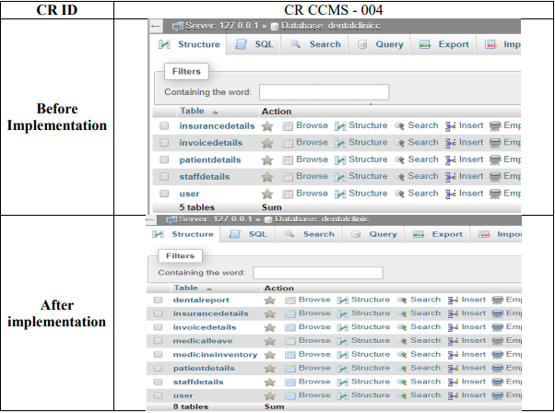

Slide 17
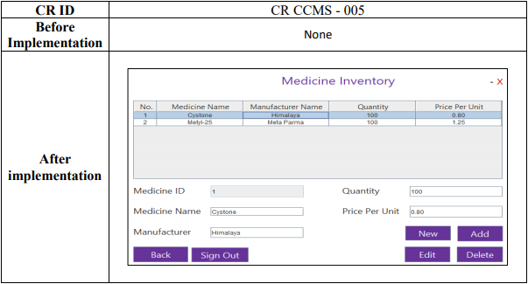

Slide 18
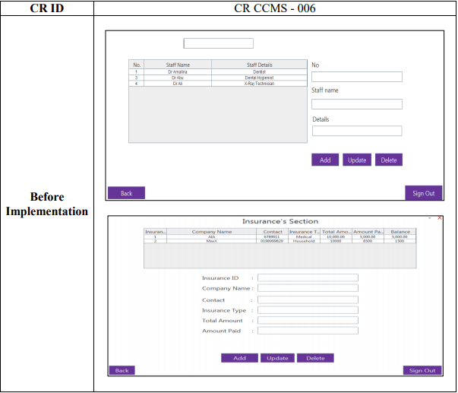

Slide 19
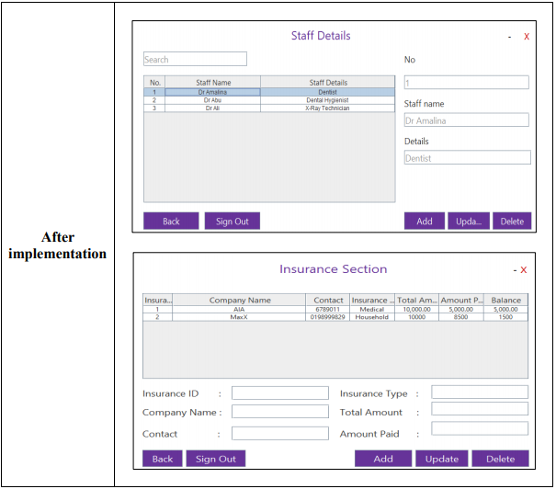

Slide 20
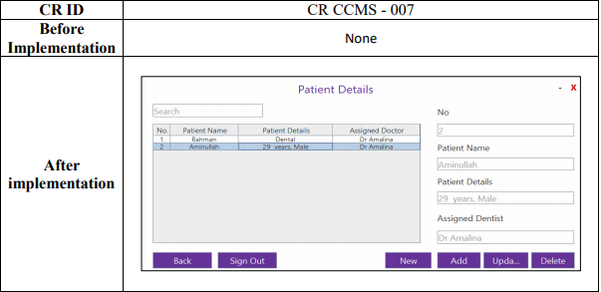

Slide 21
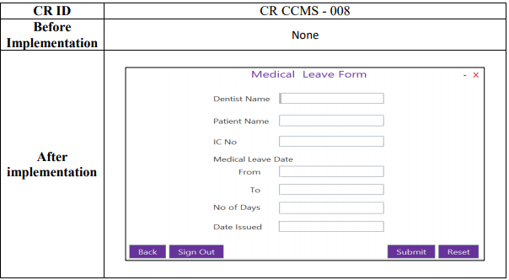

Slide 22
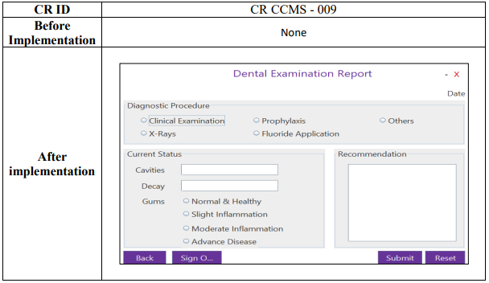

Slide 23
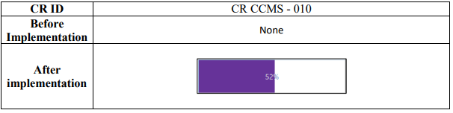

Slide 24
conclusion
the Dental Management System helps the process of managing all the patients, dentists and dental examination record in more convenient and easy way, thus reducing the time wasted and accuracy when using the old manual process. The Dental Management System must be able to provide a more efficient ways of managing daily process of Dental Clinic

